Slide 1
Signal Handling

Slide 2
Signal Handling
A signal is a notification to a process that an event has occurred.
Signals are sometimes called “software interrupts”.
Features of Signal
The process does not know ahead of time exactly when a signal will occur.
Signal can be sent by one process to another process (or to itself) or by the kernel to a process.

Slide 3
Signal Handling
Signal may be:
Synchronous
Asynchronous
Synchronous signals are delivered to the same process that performed the operation that caused the signal.
Synchronous signals include illegal memory access and division by 0.
If a running program performs either of these actions, a signal is generated and sent to same process.

Slide 4
Signal Handling
Asynchronous signal is sent to another process.
When a signal is generated by an event external to a running process, that process receives the signal asynchronously.
Examples
Terminating a process with specific keystrokes (such as <control><C>) and having a timer expire.

Slide 5
Sources for Generating Signals
Hardware
A process attempts to access addresses outside its own address space.
Kernel
Notifying the process that an I/O device for which it has been waiting is available.
Other Processes
A child process notifying its parent process that it has terminated.
User
Pressing keyboard sequences that generate a quit, interrupt or stop signal.

Slide 6
Signal Handling
19 signals in System V
Termination of a process,
Sent when a process exits or when a process invokes the signal system call with the death of child parameter;
Process induced exceptions
when a process accesses an address outside its virtual address space,
when it attempts to write memory that is read-only (such as program text) , or
when it executes a privileged instruction or for various hardware errors;
Unrecoverable conditions during a system call,
Running out of system resources during exec after the original address space has been released

Slide 7
Signal Handling
Unexpected error condition during a system call,
Making a nonexistent system call (the process passed a system call number that does not correspond to a legal system call),
Writing a pipe that has no reader processes, or
Using an illegal "reference" value for the lseek system call.
Signals originating from a process in user mode
When a process wishes to receive an alarm signal after a period of time, or (when processes send arbitrary signals to each other with the kill system call.
Terminal interaction
When a user hangs up a terminal (or the "carrier" signal drops on such a line for any reason),
When a user presses the "break" or "delete" keys on a terminal keyboard;
Signals for tracing execution of a process

Slide 8
Signal Handling
How the kernel sends a signal to a process?
How the process handles a signal? and
How a process controls its reaction to signals?
To send a signal to a process,
The kernel sets a bit in the signal field of the process table entry,
Corresponding to the type of signal received: If the process is asleep at an interruptible priority, the kernel awakens it.
The job of the sender (process or kernel) is complete.
A process can remember different types of signals, but it has no memory of how many signals it receives of a particular type.

Slide 9
Signal Handling
The kernel checks for receipt of a signal
When a process is about to return from kernel mode to user mode
When it enters or leaves the sleep state at a suitably low scheduling priority.
The kernel handles signals only when a process returns from kernel mode to user mode.
If a process is running in user mode, and the kernel handles an interrupt that causes a signal to be sent to the process, the kernel will recognize and handle the signal when it returns from the interrupt.
A process never executes in user mode before handling outstanding signals.

Slide 10
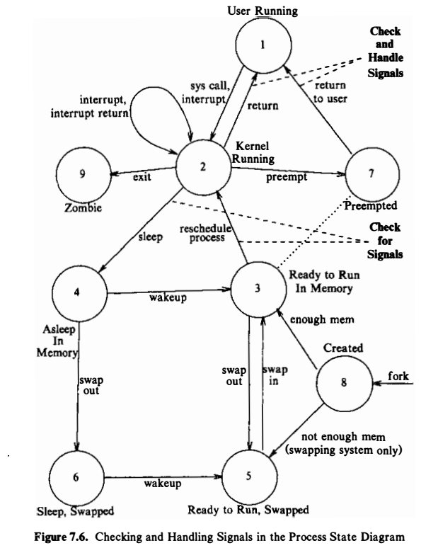
Checking and handling signals

Slide 11
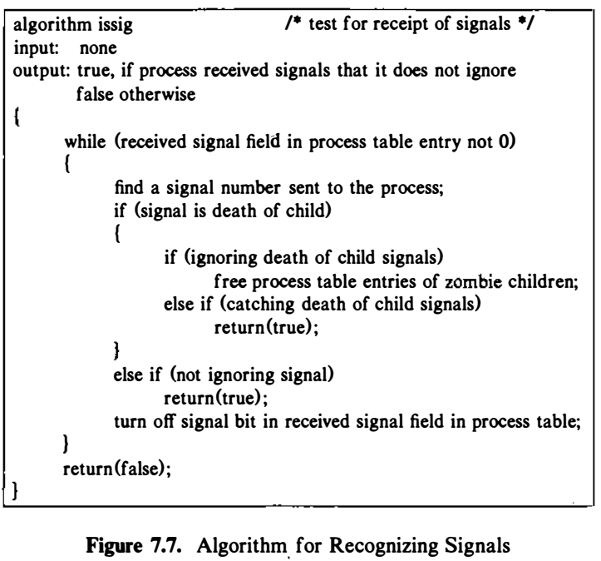
Algorithm for Recognizing Signal

Slide 12
Signal Handling
A signal may be handled by one of three possible handlers:
Ignore the signal
A process can do ignoring with all signal.
A default signal handler
Every signal has a default signal handler that the kernel runs when handling that signal.
A user-defined signal handler
This default action can be overridden by a user-define signal handler that is called to handle the signal.

Slide 13
Signal Handling
Specify a signal handler function to deal with a signal type.
signum argument is the name of the signal such as SIGALRM, SIGCHLD, etc.
signum is an integer.
The second argument, function, is a pointer to a function that takes a single integer argument and returns nothing.
The return value oldfunction was the value of function in the most recently specified call to signal for signum
Defined in <signal.h> header file
The process can pass the values 1 or 0 instead of a function
The process will ignore future occurrences of the signal if the parameter value is 1
Exit in the kernel on receipt of the signal if its value is 0 (the default value)

Slide 14
Signal Handling (contd…)
The u area contains an array of signal-handler fields, one for each signal defined in the system.
The kernel stores the address of the user function in the field that corresponds to the signal number.
Specifications to handle signals of one type has no effect on handling signals of other types

Slide 15
Signal Handling (contd…)
SIG_DFL =0 Request for default signal handling.
SIG_IGN=1 Request that signal be ignored.
SIG_ERR Return value from signal() in case of error.

Slide 16
Predefined Signals
SIGALRM: Alarm timer time-out; generated by alarm() API.
SIGILL: Execution of an illegal machine instruction.
SIGINT: Process interruption, can be generated by <Delete> or <ctrl_C> keys.
SIGSEGV: Segmentation fault; generated by de-referencing a NULL pointer.
SIGTERM: process termination; can be generated by
“kill <process_id>” command.
SIGCHLD: Sent to a parent process when its child process has terminated.

Slide 17
Signal Handling: Example
int main() { signal( SIGINT, user_fun); /* do usual things until SIGINT */
return 0; } void user_fun( int sig_no ) { /* deal with SIGINT signal */
return; /* return to program */ }

Slide 18
Signal Handling: Example
#include<signal.h>
void catch_sig(int sig_num)
{
print(“signal caught %d”, sig_num);
}
int main() { signal(SIGTERN, catch_sig);
signal( SIGINT, SIG_IGN);
signal(SIGSEGV, SIG_DFL);
pause(); return 0;
}

Slide 19
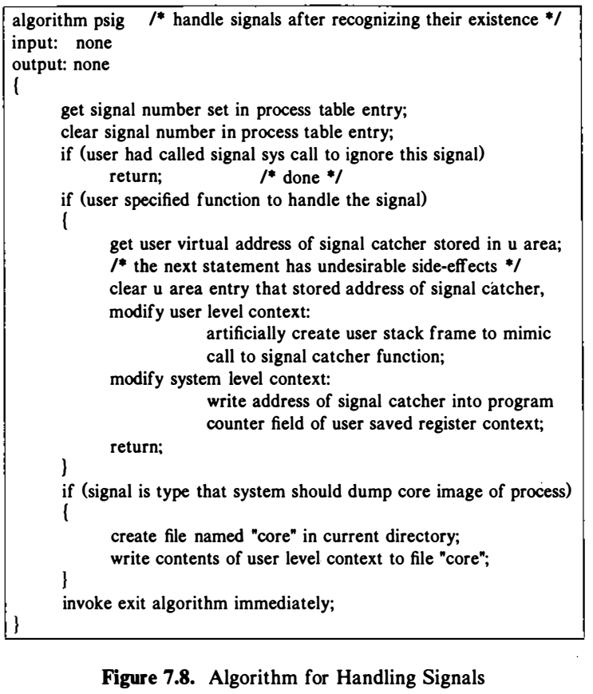
Algorithm for Handling Signal

Slide 20
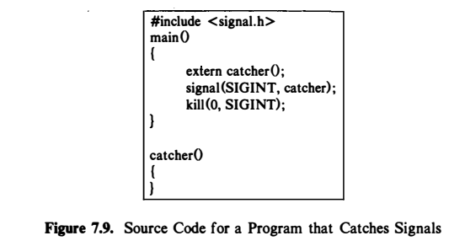
Signal Handling: Example

Slide 21
Signal Handling (contd…)
Tasks done by kernel, when a signal is decided to be handled:
The kernel accesses the user saved register context, finding the program counter and stack pointer that it had saved for return to the user process.
It clears the signal handler field in the u area, setting it to the default state.
The kernel creates a new stack frame on the user stack, writing in the values of the program counter and stack pointer it had retrieved from the user saved register context and allocating new space, if necessary. The user stack looks as if the process had called a user-level function (the signal catcher) at the point where it had made the system call or where the kernel had interrupted it (before recognition of the signal) .
The kernel changes the user saved register context: It resets the value for the program counter to the address of the signal catcher function and sets the value for the stack pointer to account for the growth of the user stack.

Slide 22
Signal Handling (contd…)
Anomalies
When a process handles a signal but before it returns to user mode, the kernel clears the field in the u area that contains the address of the user signal handling function.
Solution: If the process wants to handle the signal again, it must call the signal system call again.
Issue:
A race condition results
A second instance of the signal may arrive before the process has a chance to invoke the system call.
Since the process is executing in user mode, the kernel could do a context switch, increasing the chance that the process will receive the signal before resetting the signal catcher.

Slide 23
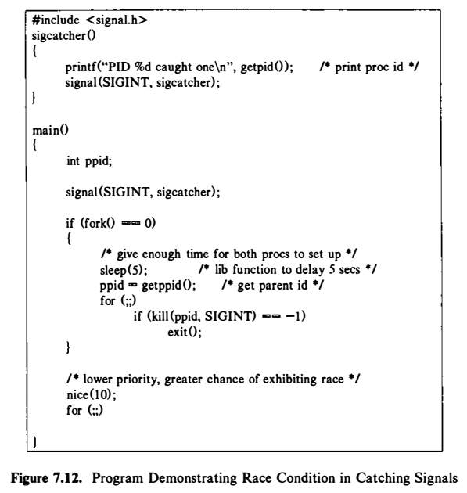
Signal Handling (contd…)
Consider the following sequence of events to occur:
The child process sends an interrupt signal to the parent process.
The parent process catches the signal and calls the signal catcher, but the kernel preempts the process and switches context before it executes the signal system call again.
The child process executes again and sends another interrupt signal to the parent process.
The parent process receives the second interrupt signal, but it has not made arrangements to catch the signal. When :it resumes execution, it exits.

Slide 24
Signal Handling (contd…)
Solution:
If the signal field were not cleared on receipt of the signal.
If signals keep arriving and are caught, the user stack could grow out of bounds because of the nested calls to the signal catcher.
The kernel could reset the value of the signal-handling function to ignore signals of that type until the user again specifies what to do for such signals.
Loss of information

Slide 25
Process Groups
The kernel uses the process group ID to identify groups of related processes that should receive a common signal for certain events.
It saves the group ID in the process table; processes in the same process group have identical group ID's.
grp = setpgrp() ;
where grp is the new process group number.
A child retains the process group number of its parent during fork.

Slide 26
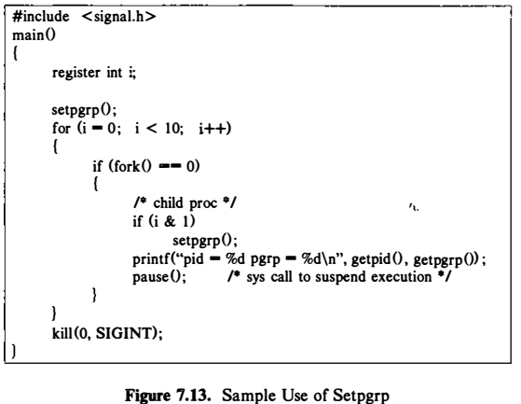
Signal: Process Groups Example

Slide 27
Kill
kill (pid, signum)
where pid identifies the set of processes to receive the signal, and signum is the signal number being sent.
Correspondence between values of pid and sets of processes:
If pid is a positive integer, the kernel sends the signal to the process with process ID pid.
If pid is 0, the kernel sends the signal to all processes in the sender's process group.
If pid is - 1 , the kernel sends the signal to all processes whose real user ID equals the effective user ID of the sender
If pid is a negative integer but not - 1 , the kernel sends the signal to all processes in the process group equal to the absolute value of pid.

Slide 28
Signal Handling- Alternate
Unix V3 and V4 did not support signal().
The alternate of signal():
#include <signal.h>
int (*sigset(int sig_no, void(*handler)(int)))(int);
sig_no argument is the name of the signal.
sig_no is an integer.
The second argument, handler, is a pointer to a function.

Slide 29
Signal Mask
The signal mask is the set of signals whose delivery is currently blocked for the caller
A process can query or set its signal mask via the sigprocmask.
Defined in <signal.h>
int sigprocmask ( int cmd, const sigset_t *new_mask, sigset_t *old_mask);
Return: Success: 0 and Failure: -1
cmd: specifies how the new_mask value is to be used:
SIG_SETMASK: Overrides the calling process signal mask with the value specified in the new_mask argument.
SIG_BLOCK: Adds the signals specified in the new_mask argument to the calling process signal mask.
SIG_UNBLOCK: Removes the signals specified in the new_mask argument from the calling process signal mask.

Slide 30
Signal Mask
new_mask: defines a set of signals to be set or reset in a calling process signal mask.
new_mask = NULL, current process signal mask unaltered.
old_mask: Address of a sigset_t variable that will be assigned the calling processing’s original signal mask.
old_mask = NULL, no previous signal mask will be return.
sigset_t: Integer or structure type of an object used to represent sets of signals.

Slide 31
Signal Mask
int sigemptyset (sigset_t* sigmask);
Clears all signal flags in the sigmask argument.
int sigaddset (sigset_t* sigmask, const int signal_num);
Sets the flag corresponding to the signal_num signal in the sigmask argument.
int sigdelset (sigset_t* sigmask, const int signal_num);
Clears the flag corresponding to the signal_num signal in the sigmask argument.
int sigfillset(sigset_t* sigmask);
Sets all the signal flags in the sigmask argument.
int sigismember(sigset_t* sigmask, const int signal_num);
Return 1 if the specified signal is a member of the specified set, or 0 if it is not. Otherwise, it return -1, to indicate the error.

Slide 32
sigprocmask Example
int main( )
{
sigset_t sigmask;
sigemptyset(&sigmask); /*initialize set */
if(sigprocmask(0,0,&sigmask)==-1)/*get current signal mask*/
{
perror(“sigprocmask”);
exit(1);
}
else
sigaddset(&sigmask, SIGINT); /* set SIGINT flag*/
sigdelset(&sigmask, SIGSEGV); /* clear SIGSEGV flag */
if (sigprocmask(SIG_SETMASK,&sigmask,0) == -1)
perror(“sigprocmask”); /* set a new signal mask */
}

Slide 33
sigprocmask Example
The example checks whether the SIGINT signal is present in a process signal mask and
Adds it to the mask if it is not there.
It clears the SIGSEGV signal from the process signal mask.

Slide 34
Reference
The Design of the UNIX Operating System, by Maurice J. Bach

